Slide 1
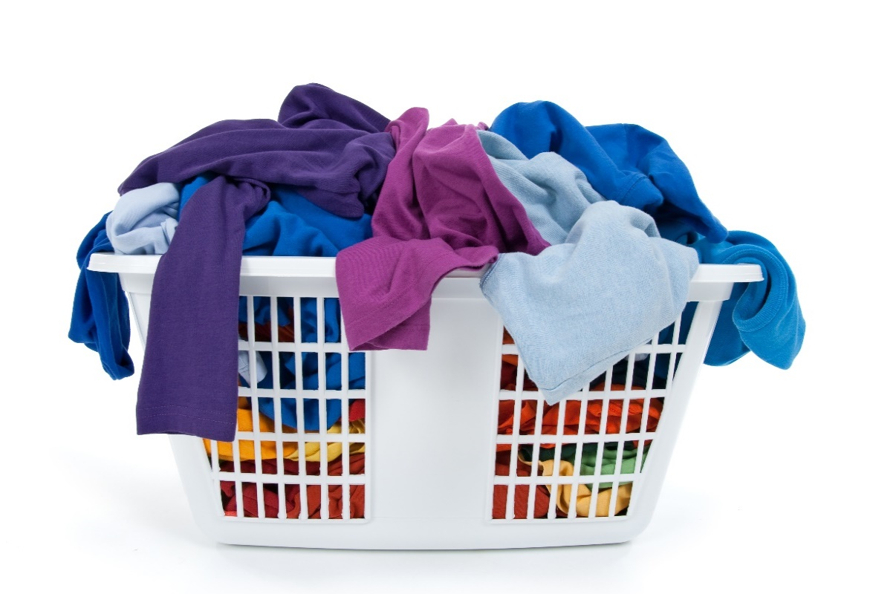
Task
uniform
Notes:
System.Threading.Task is an abstraction layer which represents both CPU bound and IO-bound operations as a uniformed API
Represents the state and outcome of an asynchronous operation executed now, later or never
This is very similar to washing clothes.
If Task represents an CPU-bound operation then, we could compare it to

Slide 2

Task
CPU-bound
Notes:
Can be compared to me doing the laundry manually
No matter whether the task is IO or CPU bound, Threads are the workers responsible for getting Tasks done that are scheduled
But with CPU bound tasks the worker thread is blocked
So that means a thread can only handle one CPU-bound task at a time

Slide 3
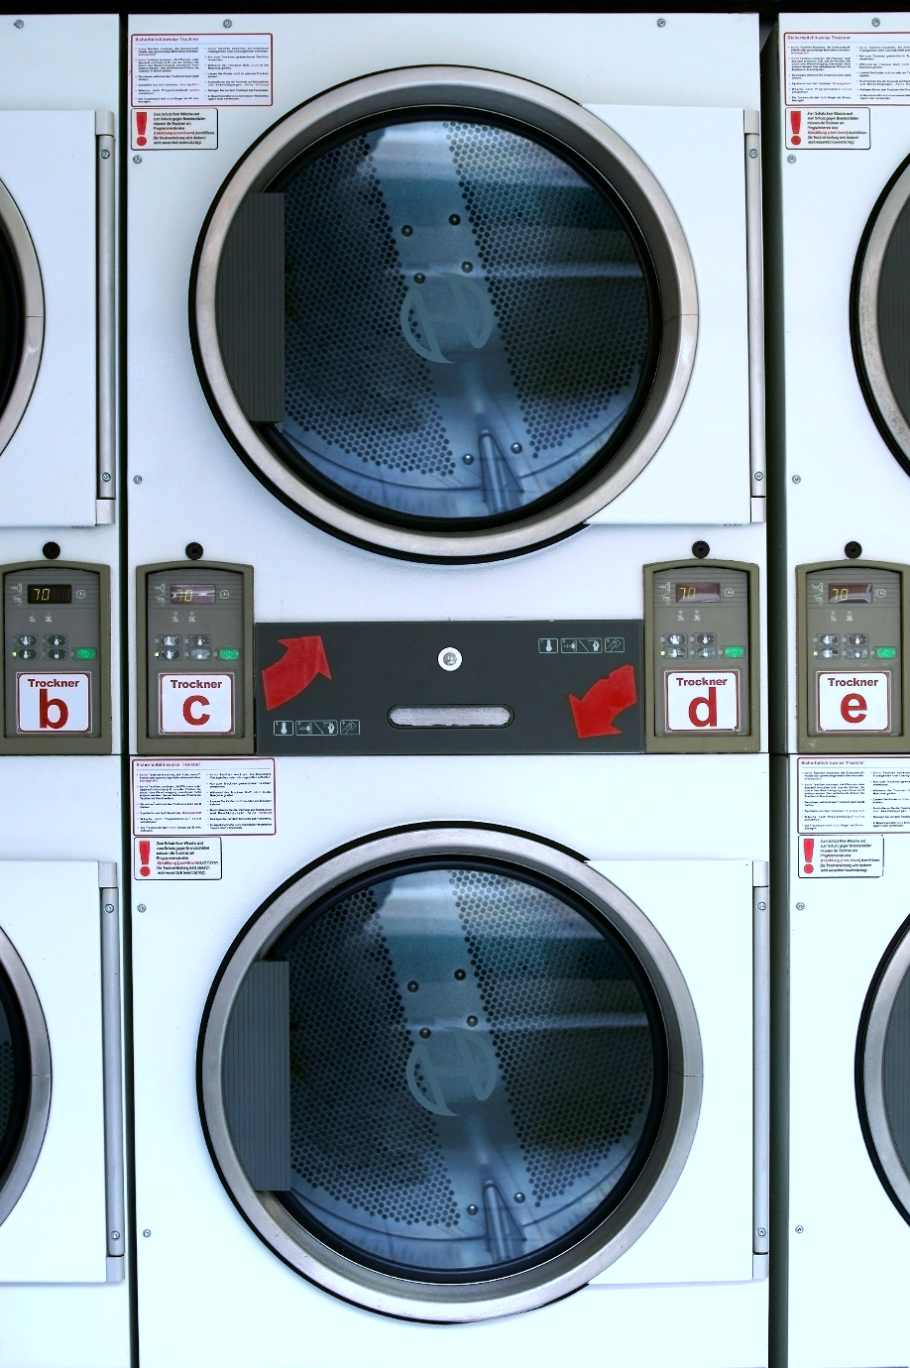
parallel
parallel
simultaneous
Notes:
Parallel can be compared to the laundromat. Multiple people can do their laundry in parallel.
In software this means
A parallel program means
Independent subexpression are evaluated simultaneously on different processors or thread
Goal: Finish computation faster
Ideally suited for CPU bound work such as sorting data in-memory, filter data
To be able to benefit from parallelism the problem needs to be dividable into induvial sub items which can be worked on independently
You can achieve parallelism using concurrency constructs but not the other way around

Slide 4

Worker pool
Task.Run
Task.Factory.StartNew
Parallel.Invoke
Parallel.For
Parallel.ForEach
Notes:
Parallel / Compute bound blocking work happens on the worker thread pool. Things like Task.Run, Factory.StartNew, Parallel.For schedule tasks on the worker thread pool.
On the other hand if we schedule Compute bound work the worker thread pool will start expanding its worker threads. This phase is called ramp up phase.
Ramping up more worker threads is expensive. The thread injection rate is limited.

Slide 5
Exercise
Notes:
ParallelInvoke
ParallelFor
ParallelForEach
TaskRun
TaskFactoryStartNew

Slide 6

async
event-driven
Notes:
Async in the real world can be compared to me doing the laundry. I put my dirty clothes into the machine and select the program or timer and let the machine do its work. Until the laundry is done, indicated by a beep of the machine, I can carry on with other things like reading the newspaper, playing with my kid…
So I, the worker, am free until signal indicates external task is done
This is very similar to software
Asynchronous program
dispatches tasks to devices that can take care of themselves, leaving the program free to do something else until it receives a signal that the results are finished
Asynchronous programming should be used for external operations which support event-driven callbacks when they are done.
Usually that is the case for IO-bound work.
For example on windows IOCompletionPorts signal the result of a IO operation back to the initiator of the operation
Async operation can be more efficient, since the worker initiating the work are not blocked.

Slide 7
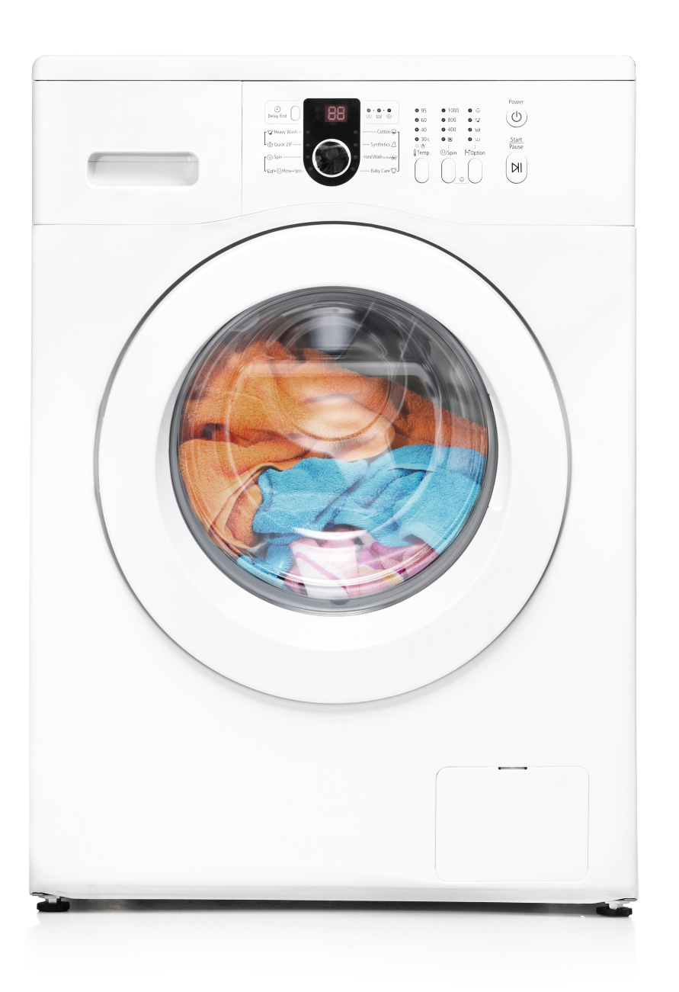
Task
IO-bound
Notes:
The laundry machine
So the state of the task representing the laundry machine would be running, not running, completed
The outcome should be clean clothes
I can late start the machine with a timer, or the machine can decide to run a health check before the process starts
It is also possible that because of failures the machine never starts
Or even more likely my wife cancels the process because yet again I’ve chosen the wrong temperature
The CPU-bound task

Slide 8
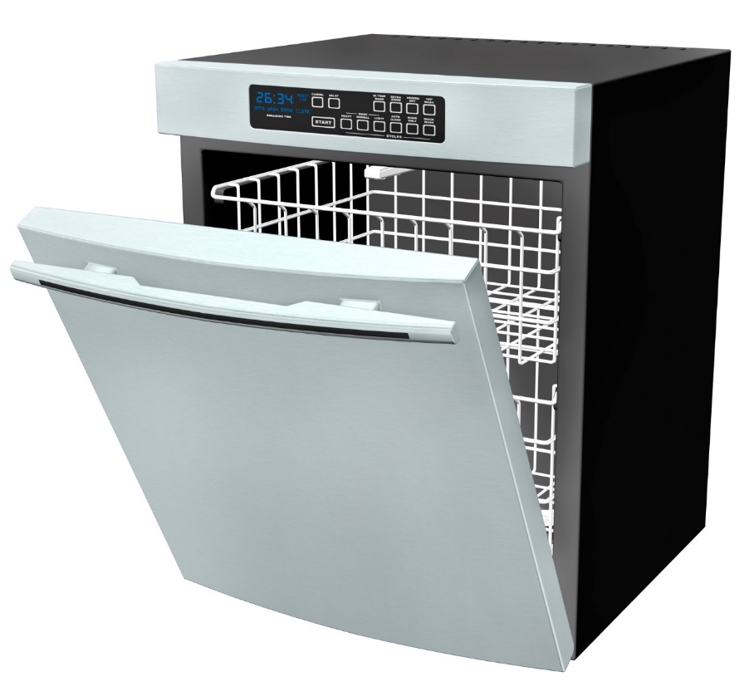

concurrent
concurrent
concurrent
concurrent
concurrent
interleaved
Notes:
Concurrent is like me while doing the laundry, I walk into the kitchen, put my newspaper away, fill the remaining dishes into the dishwasher and start the dishwasher and go back to reading the newspaper
In software this means
There is a coordinator called Scheduler which deals usually on a single thread with multiple concurrent work items
These work items can be interleaved
Depending on the scheduler work can still be distributed over threads and processors, but doesn’t have to

Slide 9
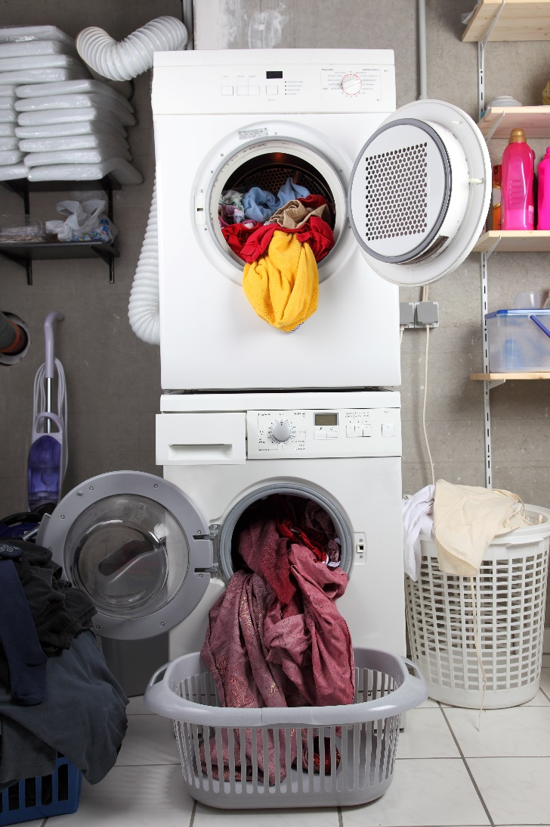
Continuation
function
Notes:
When the laundry is done, I can take out the clothes and dry them in the dryer. So drying is a continuation of the laundry.
In asynchronous programming a continuation is
A function that is scheduled for execution after its prerequisite function has completed

Slide 10
function1(function(err, res) { function2(function(err, res) { function3(function(err, res) {
function4(function(err, res) {
function5(function(err, res) {
// do something useful
})
})
}) }) })
async/await
simplicity
Notes:
The async/await keywords are here to reduce the nesting of continuations, also called christmas tree programming, and therefore simplify code drastically.
Async/wait is Syntactic sugar augmented with compiler magic

Slide 11
cleanLaundry.ContinueWith(t => {
dryLaundry;
})
Notes:
So instead of we can write

Slide 12
await cleanLaundry;
dryLaundry;

Slide 13
Exercise
SimpleAsync
FireAndForgot
Notes:
SimpleAsync
FireAndForgot

Slide 14
Recap
Use async Task instead of async void
best-practices
Notes:
Use async Task instead of async void. Task becomes the new void. Async void methods are evil. They interrupt the asynchronous flow, because the calling thread is entering the block of until it reaches the first await statement and then the operation is successfully executed for the calling thread.
they are of fire & forget nature. Any exceptions raised inside async void methods cannot be observed by the caller (unless you do fancy things with SynchronizationContexts)
(Next)

Slide 15
class VanillaHandler : IHandleMessages<AcquireVanilla> {
void Handle(AcquireVanilla message)
{
await AcquireVanillaFromGovernmentAsync();
await DownloadRecipeFromBlobStorageAsync();
await InsertVanillaUsageInDocumentDBAsync();
await StoreTelemetryDataInEventHubAsync() ;
}
}
dangerous

Slide 16
Error CS4033 The 'await' operator can only be used within an async method. Consider marking this method with the 'async' modifier and changing its return type to 'Task'.
dangerous
Notes:
ALT+Enter

Slide 17
class VanillaHandler : IHandleMessages<AcquireVanilla> {
async void Handle(AcquireVanilla message)
{
await AcquireVanillaFromGovernmentAsync();
await DownloadRecipeFromBlobStorageAsync();
await InsertVanillaUsageInDocumentDBAsync();
await StoreTelemetryDataInEventHubAsync() ;
}
}
dangerous
Notes:
Fixed. Build. Continous Integration, Continuous Deployement to the cloud, done. It’s beer’o clock lets go home
One day a really angry customer called in because their custom made chocolate bar order submitted 2 weeks ago never arrived
Project managers got angry, and the team committed to do everything they can to find out the root cause
Tracked it down to the above Handler
Weak element in the system. But why?

Slide 18
Recap
Use async Task instead of async void
Library code and framework should use ConfigureAwait(false)
best-practices

Slide 19
Recap
Use async Task instead of async void
Library code and framework should use ConfigureAwait(false)
Async all the way, don’t mix blocking and asynchronous code
best-practices
Notes:
Async all the way, means we cannot mix blocking with asynchronous code. As shown by many blog posts, talks etc. around async / await best practices (btw. You can watch my webinar recordings which I show how to access at the end of this talk if you don’t know what I’m talking about) if we mix blocking with asynchronous code we will not only be unnecessarily capturing the worker thread but also expose our code to potential deadlocks.
If we follow the rules above, the async task returning APIs ripple through the whole call stack.

Slide 20
f…
off
I don’t care about your stupid async stuff!
Notes:
Yeah but seriously f… off with your stupid async stuff. I’m working in a legacy project, I don’t have time to deal with this shit. I’m just going to integrate whatever stupid async API is coming in the future and deal with it in a synchronous blocking way.
You can do that, but it has consequences.

Slide 21
class VanillaHandler : IHandleMessages<AcquireVanilla> {
void Handle(AcquireVanilla message)
{
AcquireVanillaFromGovernmentAsync().Result;
DownloadRecipeFromBlobStorageAsync().Wait();
InsertVanillaUsageInDocumentDBAsync().Result;
StoreTelemetryDataInEventHubAsync().Wait();
}
}
cumbersome
Notes:
Different API calls to remember depending whether it is a Task or a Task returning a result (.Wait() or .Result())
Masks the original exception and wraps it in an AggregateException (can make debugging and searching for the root cause cumbersome)
Unnatural environment for developers already knowing the async/await keywords

Slide 22
class VanillaHandler : IHandleMessages<AcquireVanilla> {
void Handle(AcquireVanilla message)
{
AcquireVanillaFromGovernmentAsync().Result;
DownloadRecipeFromBlobStorageAsync().Wait();
InsertVanillaUsageInDocumentDBAsync().Result;
StoreTelemetryDataInEventHubAsync().Wait();
}
}
wasteful
Notes:
Blocking calls hold captive the entering thread
At first sight this doesn’t seem like a big deal.

Slide 23
NServiceBus
26 times
Azure Service Bus
Azure Storage Queues
6 times
RabbitMQ
5 times
MSMQ
3 times
more message throughput
https://particular.net/blog/rabbitmq-updates-in-nservicebus-6
https://github.com/Particular/EndToEnd/tree/master/src/PerformanceTests
Notes:
Attention the results may vary drastically depending on the azure latency and the hardware used on prem for MSMQ.
And this is only raw throughput measured. Everything else is also asynchronous like persistence, file transfers and so on. We also see much better ressource usage like using less threads more efficiently. Less CPU usage while high IO usage…
If you don’t believe me go have a look end2end
So if we want to benefit from asynchronous programming we have to (next slide)

Slide 24
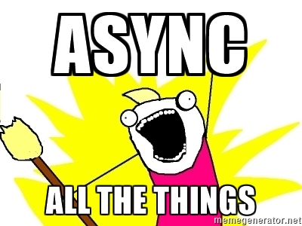
Notes:
ASYNC ALL THE THINGS

Slide 25
viral
Async / await
is
Notes:
Async /await is viral. Like a highly infectious deceases it starts spreading all over the place as soon as you have it.

Slide 26
but
Notes:
But

Slide 27
It kicks your
servers
butt
Notes:
It kicks your servers butt
On a server every thread that can be freed up is worth freeing up. On a server the comparison has to be done between asynchronous code and parallel code. Asynchronous code blow parallel code out of the water.
In order to understand why we need to explore how windows handles compute bound work and IO-bound work. We have two thread pools

Slide 28
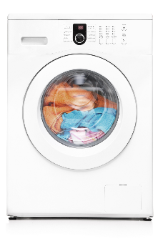

Worker pool
IO pool
Task.Run
Task.Factory.StartNew
Parallel.For
Parallel.ForEach
await iobound
iobound.FireForget()
Notes:
async can handle bursting traffic better; the IOCP is "always-on", so to speak.
IO-bound work is scheduled on the IO-thread pool. The IO-bound thread pool has a fixed number of worker threads (usually number of cores) which can work concurrently on thousands of IO-bound tasks. The point of IOCP is to efficiently offload IO work from user code to kernel and driver and hardware and not to bother the user code until the IO work is done. To achieve that, the user code layer registers for being notified of the IO operation to be complete.
That notification occurs in form of a callback on an IO thread, which is a pool thread managed by the IO system that is made available to the user code.
Next slide!

Slide 29
Worker pool
IO pool
Task.Run
Task.Factory.StartNew
Parallel.For
Parallel.ForEach
await iobound
iobound.FireForget()
Notes:
As IO typically takes very long and compute work is comparatively cheap, the goal of the IO system is to keep the thread count low (ideally one per core) and schedule all callbacks (and thus execution of interleaved user code) on that one thread. That means that, ideally, all work gets serialized and there minimal context switching as the OS scheduler owns the thread. async uses much less memory allocation (and that's where most of the scalability benefits come from): the amount of memory saved by freeing up a thread (and its massive stack) dwarfs the amount of memory used for all the async structures combined.
Interestingly, if you examine each request in isolation, it would actually be (slightly) slower than the synchronous version (since there is the extra kernel transition, etc); but the scalability more than makes up for it.
Also, from the server perspective, So, if you compare asynchrony to synchrony - just looking at one method or one request - then synchrony makes more sense. But if you compare asynchrony to parallelism - looking at the server as a whole - then asynchrony generally wins.

Slide 30
Exercise
AsyncVoid
ConfigureAwait
AsyncAllTheWay
SequentialExecution
Notes:
AsyncVoid
ConfigureAwait
AsyncAllTheWay
SequentialExecution

Slide 31
Implicit execution concurrency
Code flow is sequential
await Method1();
try { await Method2(); } catch() { }
If you stick to that almost nothing can go wrong

Slide 32
Dangerzone

Slide 33
Explicit execution concurrency
Method1Async();
Method2Async();
WhenAll / WhenAny
ContinueWith
From now on more than a code monkey brain is required

Slide 34
var syncEvent = new ManualResetEvent(false);
var t1 = Task.Run(() => {
syncEvent.WaitOne();
});
var t2 = Task.Run(() => {
Thread.Sleep(2000);
syncEvent.Set();
});
await Task.WhenAll(t1, t2);
ManualResetEvent

Slide 35

void stinks
wait smells
Remember
Async all the way means avoid blocking code
Notes:
Use another icon

Slide 36
Ambient state

Slide 37

Ambient state
class ClassWithAmbientState
{
static ThreadLocal<int> ambientState = new ThreadLocal<int>(() => 1);
public void Do()
{
ambientState.Value++;
}
}
watch!
Notes:
Maybe just refer to my blog post

Slide 38
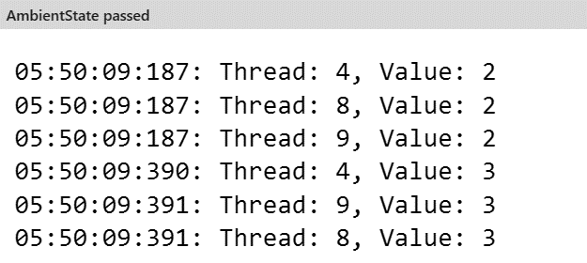
Ambient state
var instance = new ClassWithAmbientState();
var tasks = new Task[3];
for (int i = 0; i < 3; i++) {
tasks[i] = Task.Run(() => {
instance.Do();
Thread.Sleep(200);
instance.Do();
});
}
await Task.WhenAll(tasks);
watch!
Notes:
Maybe add RPC??

Slide 39

Older constructs bound to threads
fall apart in the async/await world
Remember
Notes:
Use another icon

Slide 40
Task
Forget thread!
think
Notes:
Stop thinking in threads. For most applications threads are no longer relevant. Think in Tasks. Rest assured the TPL runtime is heavily optimized for most production scenarios.
Stick to sequential execution as long as you can only if you really need explicit concurrency or parallelism go into the dangerzone

Slide 41
Exercise
DangerZone
All the other exercises until Concurrency Limit ;)
Notes:
ConcurrentExecutionAll
ConcurrentExecutionOne
ParallelExecution
CancelTask
CancelTaskOperation
ConcurrencyLimit

Slide 42


Message Pump
Your Code
PickMessageFrom Transport
DetermineCodeTo Execute
Queue
RetryOnFailure
Deserialize Message
Notes:
Handling a message from a queue can also be implemented as a chain of responsibility.
Each operation, such as picking up the message from the transport of choice, can be thought of as a link in the message-handling chain. Because the chain is stored in a List, links can be added, removed, or reordered. You can make those changes at design time, or at runtime. There is a lot of flexibility in this chain of responsibility.

Slide 43
Exercise
Your Pump
Notes:
YourPump
TaskCompletionSource

Slide 44
Exercise
Multi Producer Concurrent Consumer
Notes:
MultiProducerConcurrentConsumer

Slide 45
Testing
Notes:
Pure async is like sync, nothing special
In combination with the TPL don’t make things out. We showed how when things get isolated properly even complex structures like MPCC can be easily tested
Avoid fancy stuff like AsyncLocal, it is going to bite you

Slide 46
Debugging
Notes:
Use TracePoints
Debugger.WriteLine
Look at DotTrace or similar tools to see what is going on during runtime

